Slide 1
Object Oriented Programming in Python
Clay Elmore
February 1, 2019

Slide 2
Procedure Oriented Programming
“Traditional Programming”
Code manipulates existing data
Data and actions are inherently separate
“Routines” (functions) determine the program
C, Fortran are perfect examples

Slide 3
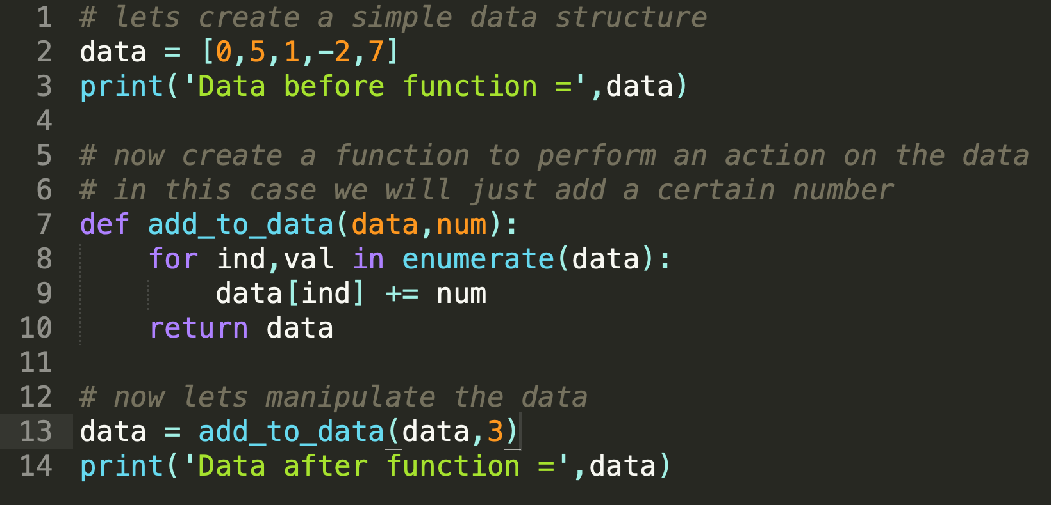
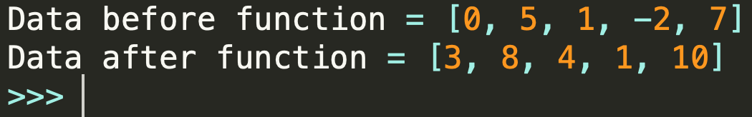
POP Example

Slide 4
Object Oriented Programming
Data and actions inherently coupled
Main Concepts:
Data Specification (Encapsulation)
Object Relationships (Inheritance)
Action Flexibility (Polymorphism)
Python, Java, C++, C Sharp are great OOP examples
Source: https://www.quora.com/What-are-the-three-principles-of-object-oriented-programming

Slide 5
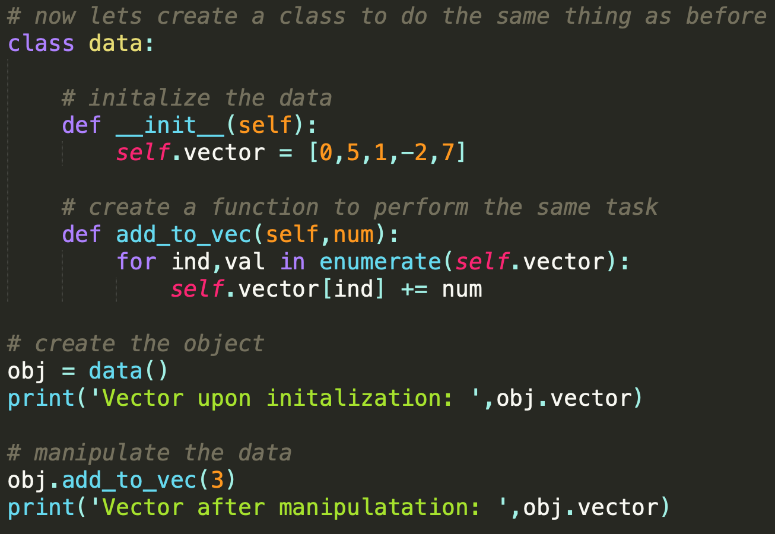
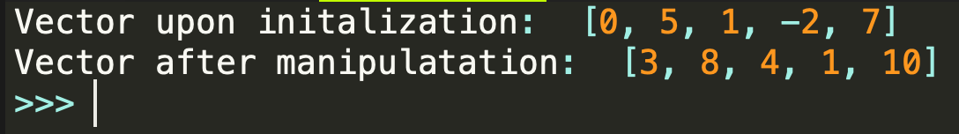
Simple Python OOP Example

Slide 6
Comparison

Slide 7
Reasons to use OOP
Code is EXTREMELY reusable
Large scale development is much easier
Code is generally more robust in OOP vs POP
Parallelizing tasks is easy
GitHub community loves you

Slide 8
Downfalls of OOP
Harder to write extremely fast OOP for mathematics
C and Fortran run the HPC world
This is starting to change with things like TensorFlow
Non-optimized OOP can use a lot of memory
Always try to use “commercial” grade objects (NumPy, Pandas)

Slide 9
Recommendations of IDE’s for OOP
 | Spyder | Sublime Text | PyCharm
Pros | Easy to learn Works out of the box | Extremely customizable Huge community of users | Maybe the most versatile OOP IDE Hugely connected with conda Full IDE
Cons | Not many features Not very customizable | Bad Python environment to start Needs some work to be useful Not a full IDE | Extremely difficult to learn Probably will not work out of the box as you want it to

Slide 10
Questions Before Moving to Jupyter
?

